Slide 1
Randomisation in Coin Tosses
We can’t predict the result of one coin toss with certainty but we have an expectation that with 10 tosses we will get about half,
or 5 heads.
There will be quite a lot of variation, however, about our expectation for such a small number of tosses.
The next few slides show the variation in the number of heads in 10 trials of 10 tosses of
a coin.

Slide 2
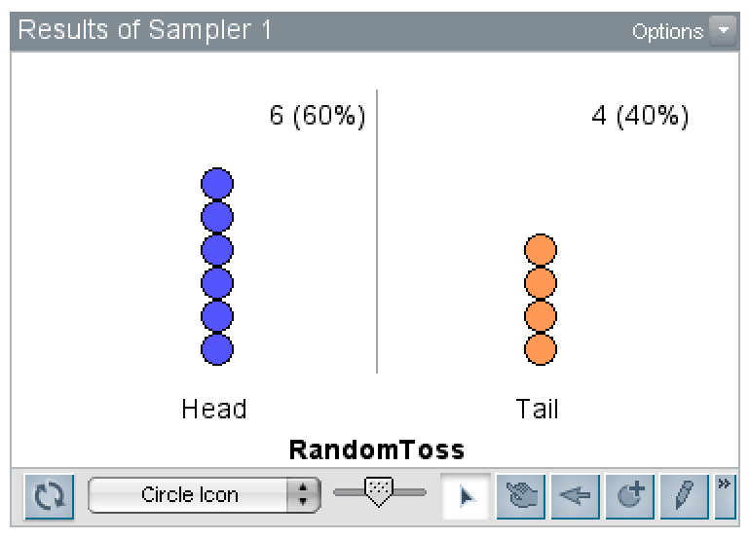
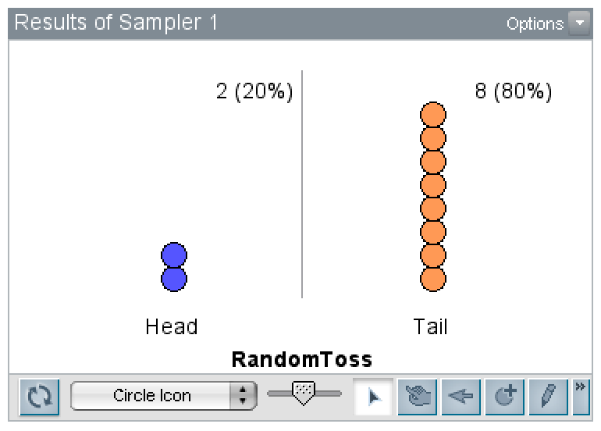
10 Tosses

Slide 3
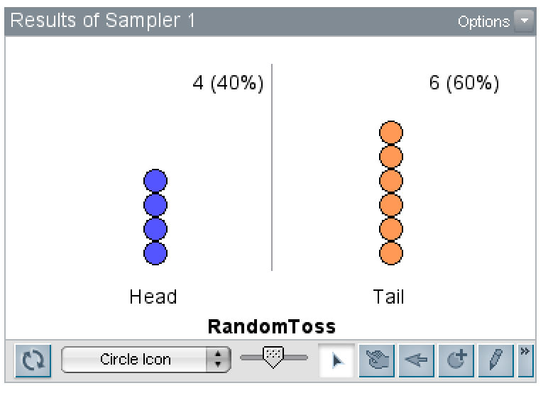
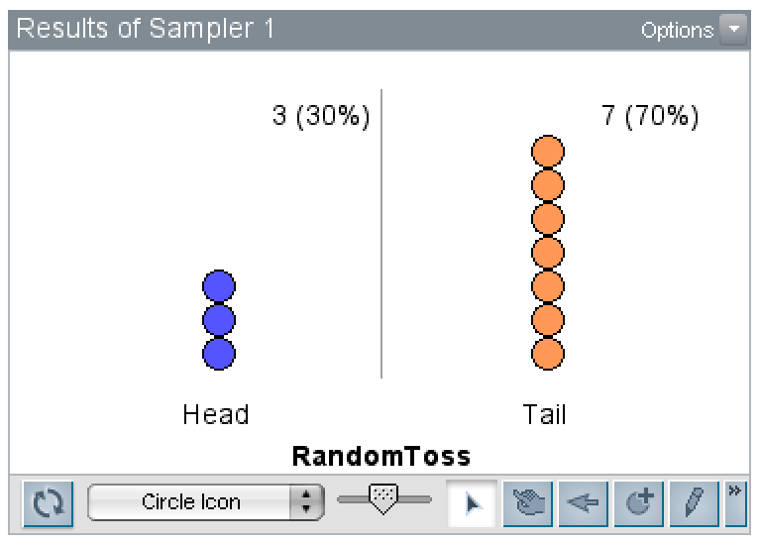
10 Tosses

Slide 4
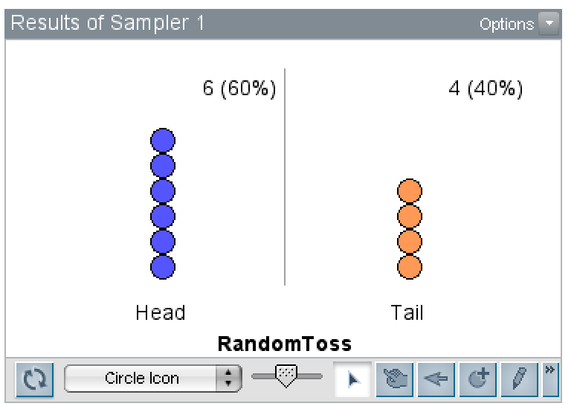
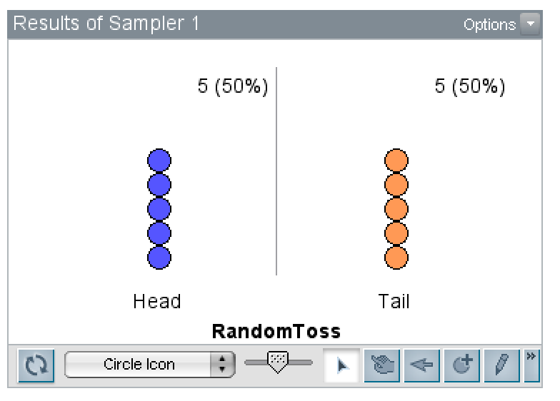
10 Tosses

Slide 5
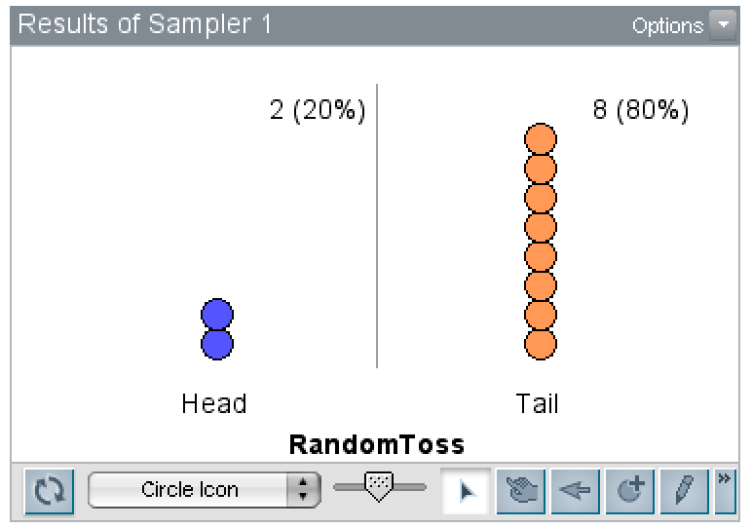
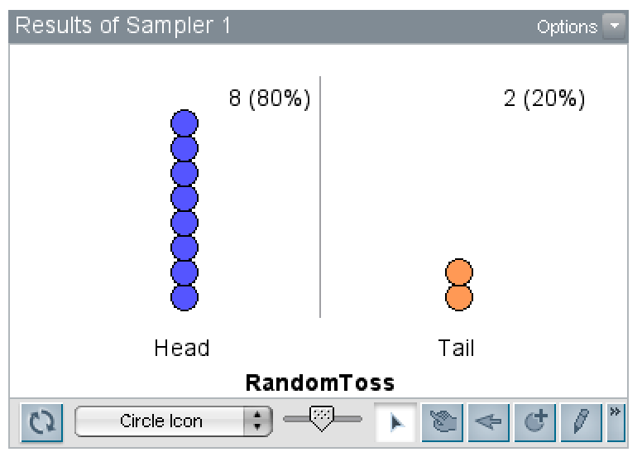
10 Tosses

Slide 6
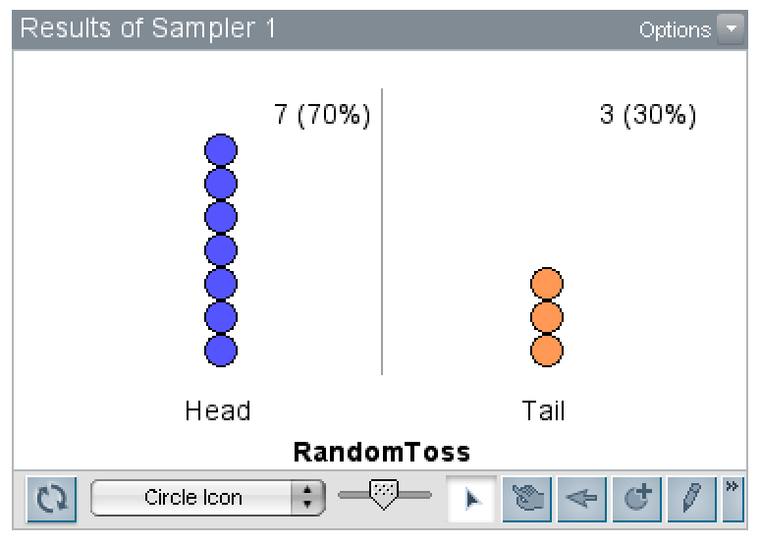
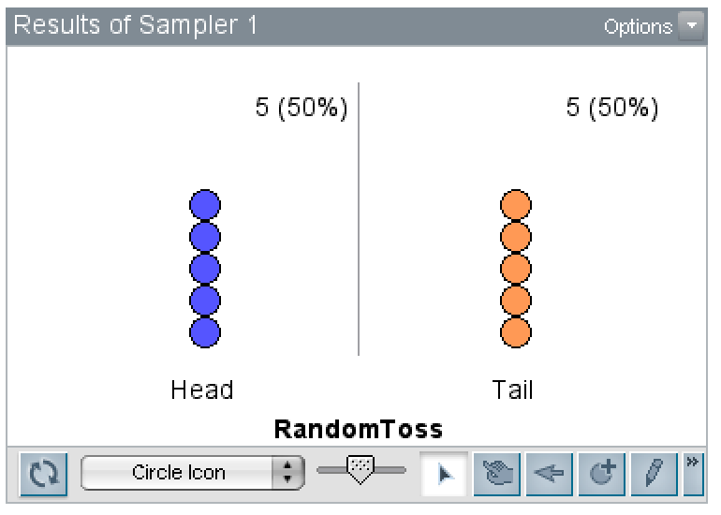
10 Tosses

Slide 7
Increasing the number of coin tosses
We are now going to see the result of simulating 20 coin tosses and the number and percentage of Heads and Tails obtained.
Each time more simulated tosses are added to those already completed, there should be less variation from the expected 50%:
  +30 +50
  +100 +200
  +500 +1000
  +1000 +3000

Slide 8
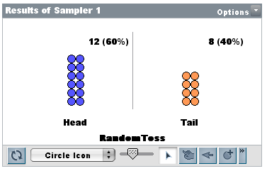
20 Tosses

Slide 9
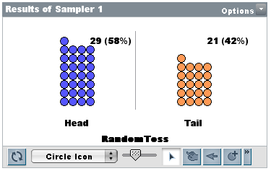
50 Tosses

Slide 10
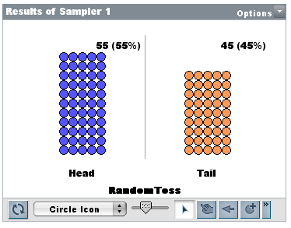
100 Tosses

Slide 11
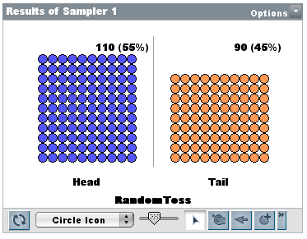
200 Tosses

Slide 12
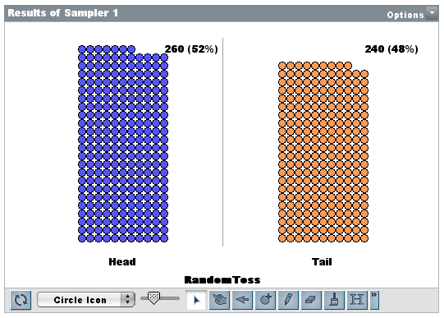
500 Tosses

Slide 13
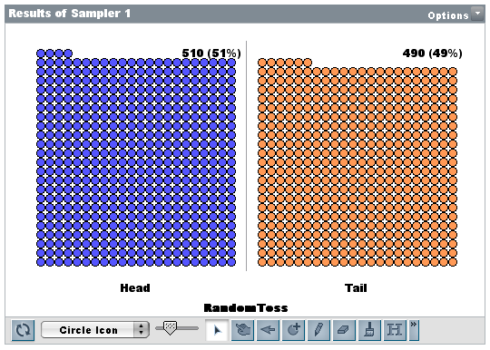
1000 Tosses

Slide 14
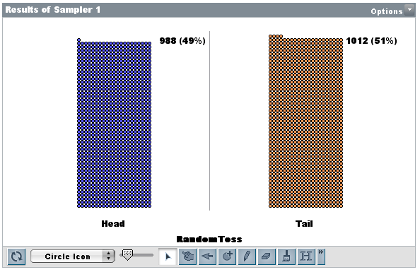
2000 Tosses

Slide 15
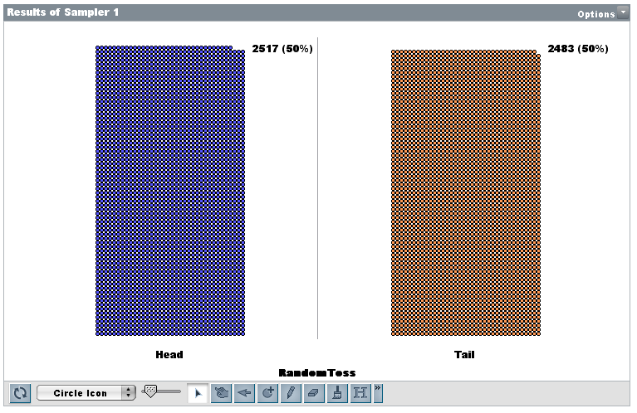
5000 Tosses

